Slide 1

Title: Pneumonia Chest X-ray classification using Machine Learning

Slide 2

Group members: Anudeep Allamsetty-700741171 Vishnu Vardhan Reddy Gooli-700734980 Karthik Bathula-700743520

Slide 3

Roles and Responsibilities: Anudeep and Vishnu built the code together. Karthik made the documentation. We worked together as a team and got everything figured out
Motivation:
We chose this project because of the impact lung diseases like TB or pneumonia have on millions of people. So, we can classify pneumonia from regular chest x-ray as early detection and diagnosis is the key in its treatment.

Slide 4

Objectives: The primary objective of this project is to develop ensemble models based on the Stacking Classifier, Voting Classifier, and Bagging Classifier algorithms for accurate pneumonia classification. This involves the following specific objectives: 1.Collecting and preprocessing a large dataset of labeled chest X-ray images with pneumonia cases. 2.Implementing the ensemble models using the appropriate algorithmic configurations. 3.Training and fine-tuning the ensemble models on the collected dataset. 4.Evaluating the performance of the ensemble models on a separate test set of labeled chest X-ray images with pneumonia cases. 5.Optimizing the ensemble models to achieve higher accuracy and efficiency in pneumonia classification. By adopting these objectives, we aim to create ensemble models that surpass the performance of individual classifiers, enabling accurate and efficient classification of pneumonia cases using chest X-ray images.

Slide 5

Q. How to classify pneumonia from regular chest X-rays? A. We use five steps to distinguish between pneumonia and regular chest X-rays using Machine Learning. They are as follows: 1. Data set Loading- Loads images 2. Data set visualization- Visualizes images 3. Defining algorithms and data set models 4. Training- combines algorithms and data 5. Evaluation- evaluating how good our model is performing

Slide 6
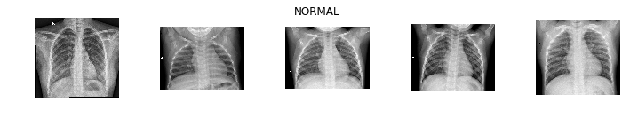
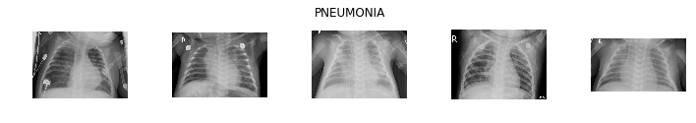
Datasets: Each image category (Pneumonia/Normal) has its own subfolder within the dataset, which is arranged into three folders (train, test, and validation). 5863 X-Ray images (JPEG) are available, divided into two groups (Pneumonia/Normal).
Fig 1. Sample Images from Dataset

Slide 7
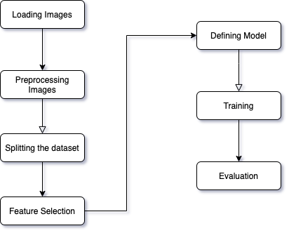
Overview of System Model

Slide 8
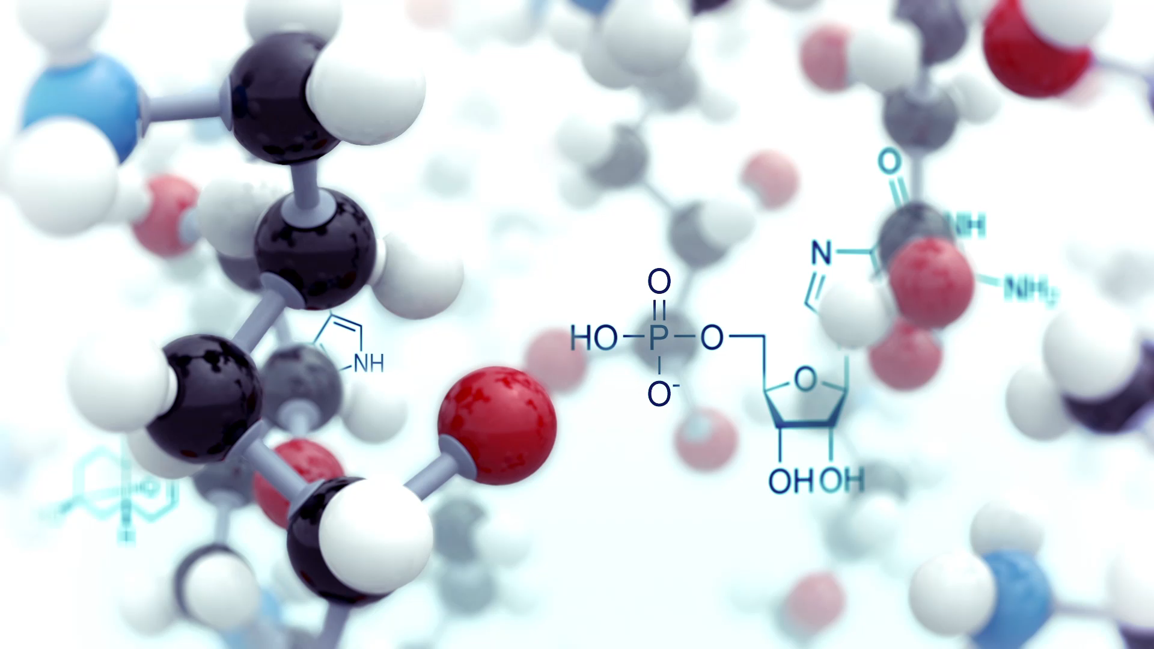
Modeling: The proposed pneumonia classification model combines the strengths of ensemble-based machine learning algorithms, namely StackingClassifier, VotingClassifier, and BaggingClassifier, to achieve accurate classification of chest X-ray images. . 1. The StackingClassifier is utilized as the primary classifier in the ensemble, responsible for distinguishing between normal and pneumonia cases. It combines the predictions of multiple base classifiers and uses a meta-classifier to make the final classification decision. 2. The VotingClassifier aggregates the predictions of individual classifiers using a voting scheme, 3. The BaggingClassifier trains multiple classifiers on bootstrapped samples of the dataset and combines their predictions.

Slide 9
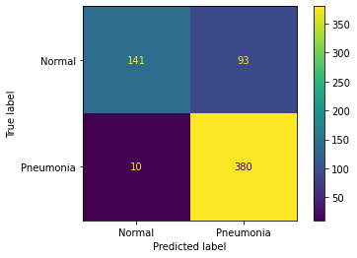
Results:
pneumonia classification.
Fig 7. Confusion Matrix of Stacking Classifier Fig 8. Confusion Matrix of Voting Classifier
Fig 9 Confusion Matrix of Bagging Classifier

Slide 10
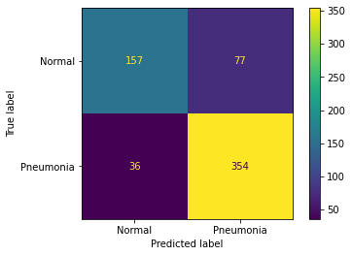
Fig 9 Confusion Matrix of Bagging Classifier
In our experiments, we employed ensemble learning techniques such as Stacking Classifier, Voting Classifier, and Bagging Classifier to enhance the classification performance. The Stacking Classifier achieved an accuracy of 0.8349, while the Voting Classifier and Bagging Classifier achieved accuracies of 0.8157 and 0.8189, respectively.

Slide 11

Related Work: 1. "CheXNet: Radiologist-Level Pneumonia Detection on Chest X-Rays with Deep Learning" by Rajpurkar et al. (2017): This study introduced CheXNet, a deep learning model trained on a large dataset of chest X-ray images to classify pneumonia. 2. "Deep Learning-Based Pneumonia Detection on Chest X-Rays: A Survey" by Islam et al. (2019): This survey paper provides an overview of various deep learning approaches for pneumonia classification using chest X-ray images. 3. "Automated Pneumonia Detection from Chest X-Ray Images using Deep Learning" by Kumar et al. (2020): In this research, a deep learning-based approach was developed to automatically detect pneumonia from chest X-ray images. 4. "Pneumonia Detection Using Convolutional Neural Networks" by Liang et al. (2018): This study explored the use of CNNs for pneumonia classification on chest X-ray images. 5. "Pneumonia Detection from Chest X-Rays with Transfer Learning" by Haque et al. (2019): The research focused on transfer learning techniques for pneumonia classification.

Slide 12

References: 1. Obaro SK, Madhi SA. Bacterial pneumonia vaccines and childhood pneumonia: are we winning, refning, or redefning? Lancet Infect Dis. 2006;6(3):150–61. 2. Pound MW, Drew RH, Perfect JR. Recent advances in the epidemiology, prevention, diagnosis, and treatment of fungal pneumonia. CurrOpin Infect Dis. 2002;15(2):183–94. 3. Virkki R, Juven T, Rikalainen H, Svedström E, Mertsola J, Ruuskanen O. Diferentiation of bacterial and viral pneumonia in children. Thorax. 2002;57(5):438–41. 4. Jones RN. Microbial etiologies of hospital-acquired bacterial pneumonia and ventilator-associated bacterial pneumonia. Clin. Infect. Dis. 2010;51(Supplement_1):S81–7. 5. Ruuskanen O, Lahti E, Jennings LC, Murdoch DR. Viral pneumonia. The Lancet. 2011;377(9773):1264–75. 6. World Health Organization. Revised WHO classifcation and treatment of childhood pneumonia at health facilities: evidence summaries. Geneva: World Health Organization; 2014.

Slide 13

Thank you

